Slide 1



Protein domains with unbalanced amino acid usage are differentially lost
Garret Wilson^{1,2}
Mentor: Sawsan Wehbi³
Contributors : Raymond Hon¹, Andrew Wheeler³, & Joanna Masel⁴
⏤
Arizona NASA Space Grant Statewide Student Research Symposium
Tucson, Arizona
April 20th, 2024
¹Molecular & Cellular Biology, University of Arizona
²Computer Science, University of Arizona
³Genetics Graduate Interdisciplinary Program, University of Arizona
⁴Department of Ecology and Evolutionary Biology, University of Arizona, Tucson, AZ, 85721, USA

Slide 2

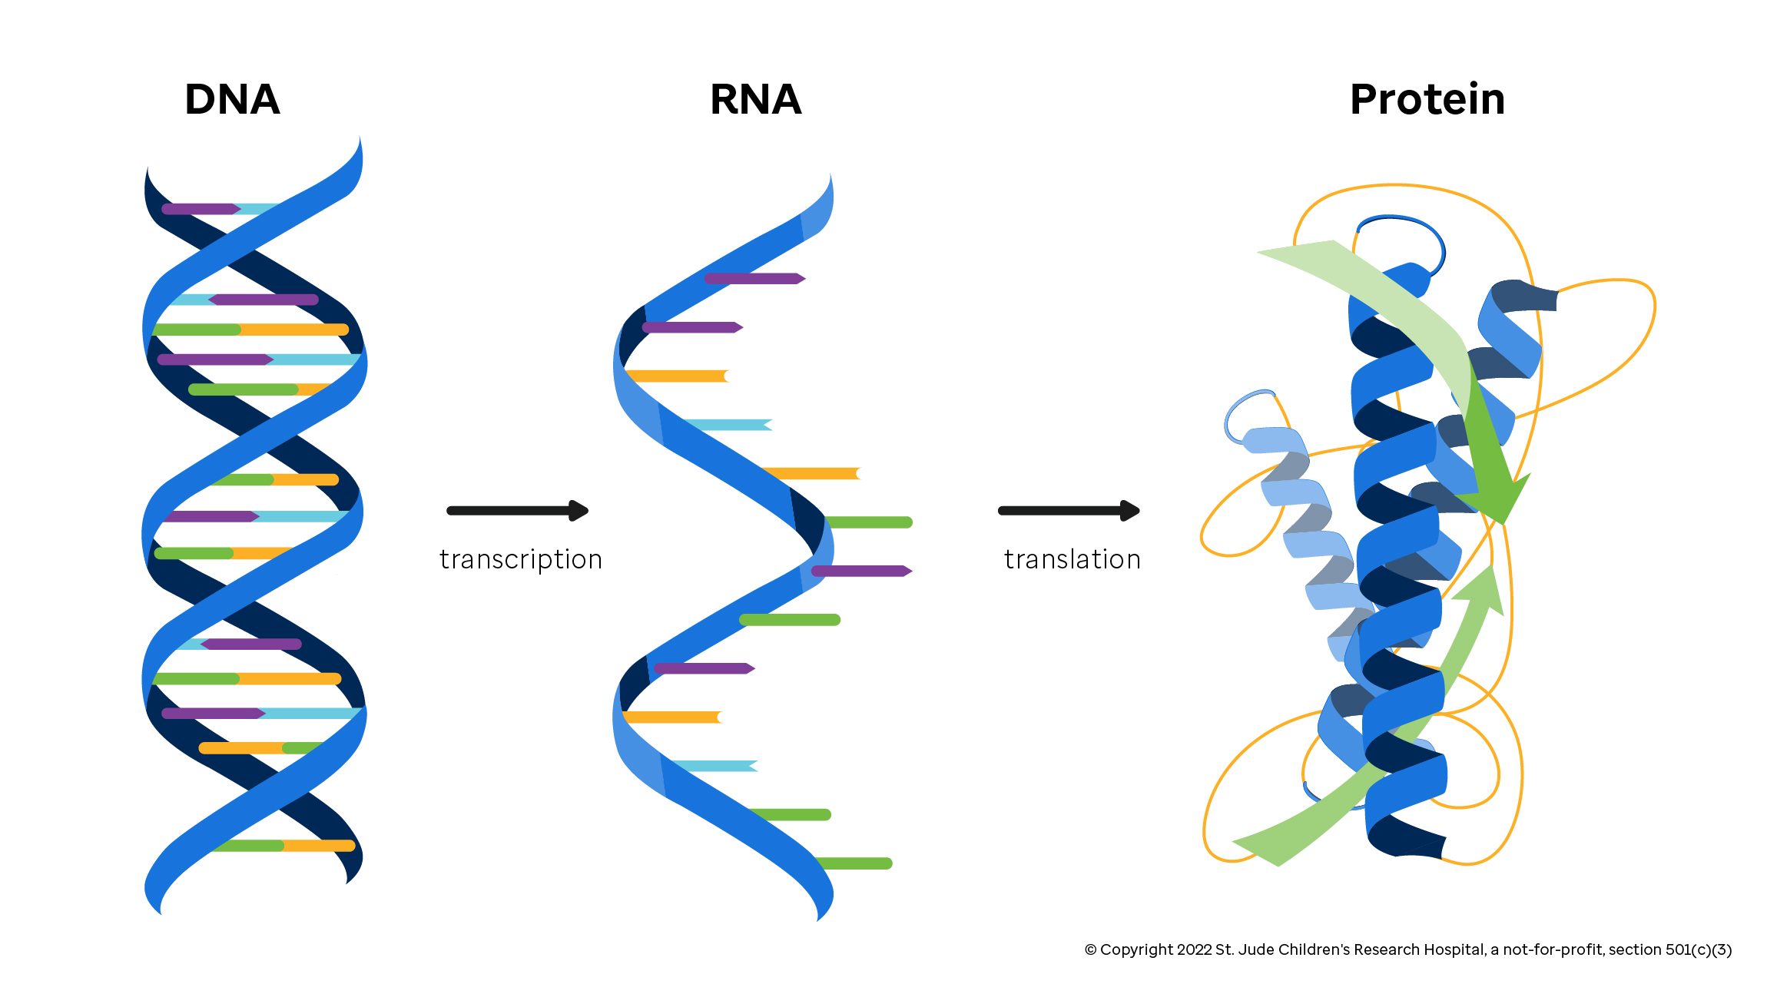
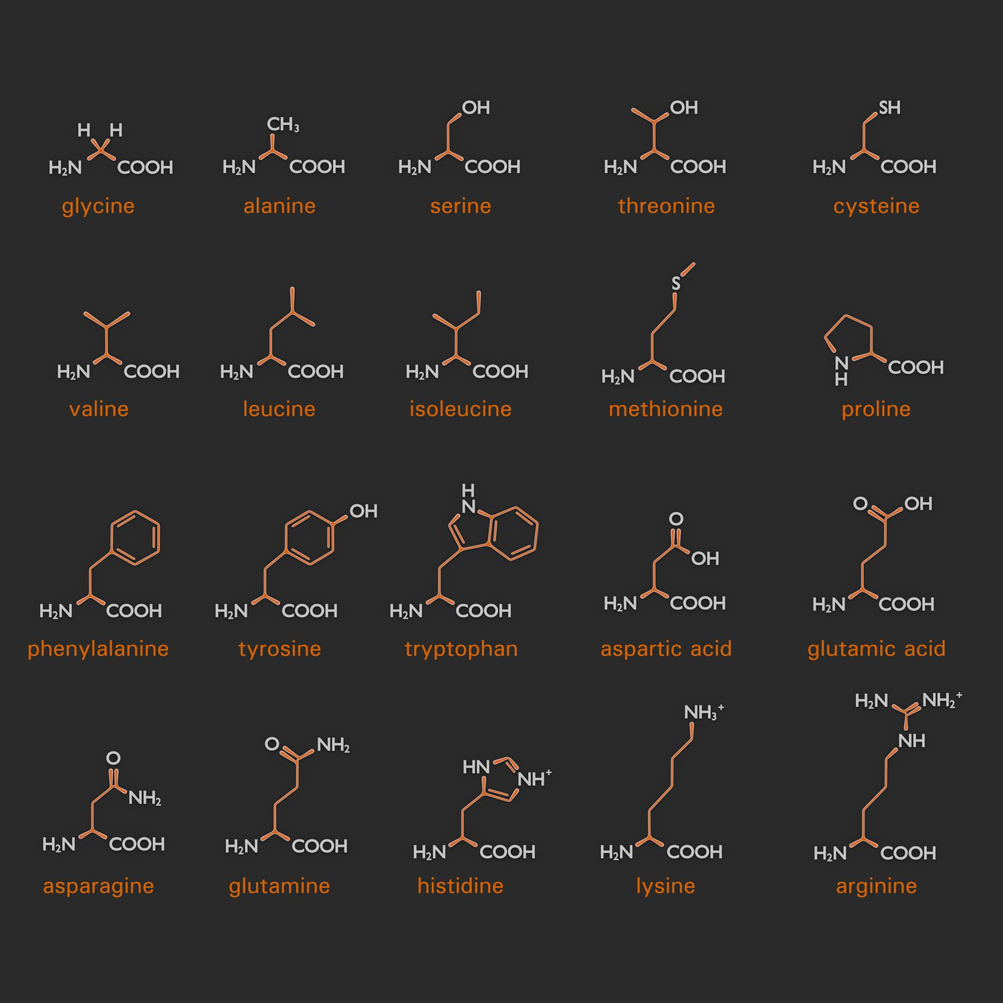
Background
Central dogma of biology
Ingredients that make up proteins (amino acids)
What the data we used looked like:
RMEDRPGLKEYCKQRNRAKIPVRMENRPGLKPYCKQRNRAKIED

Slide 3
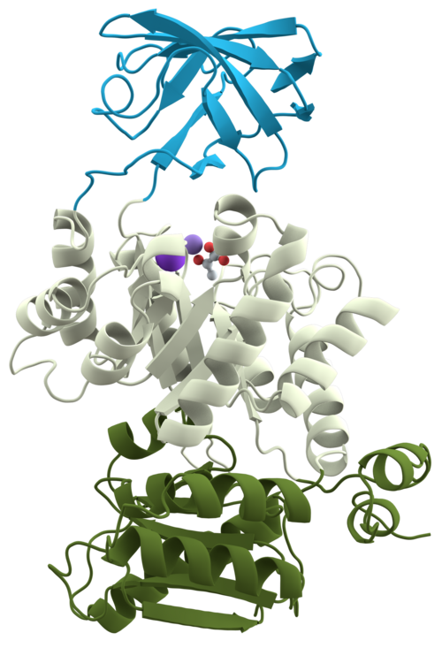
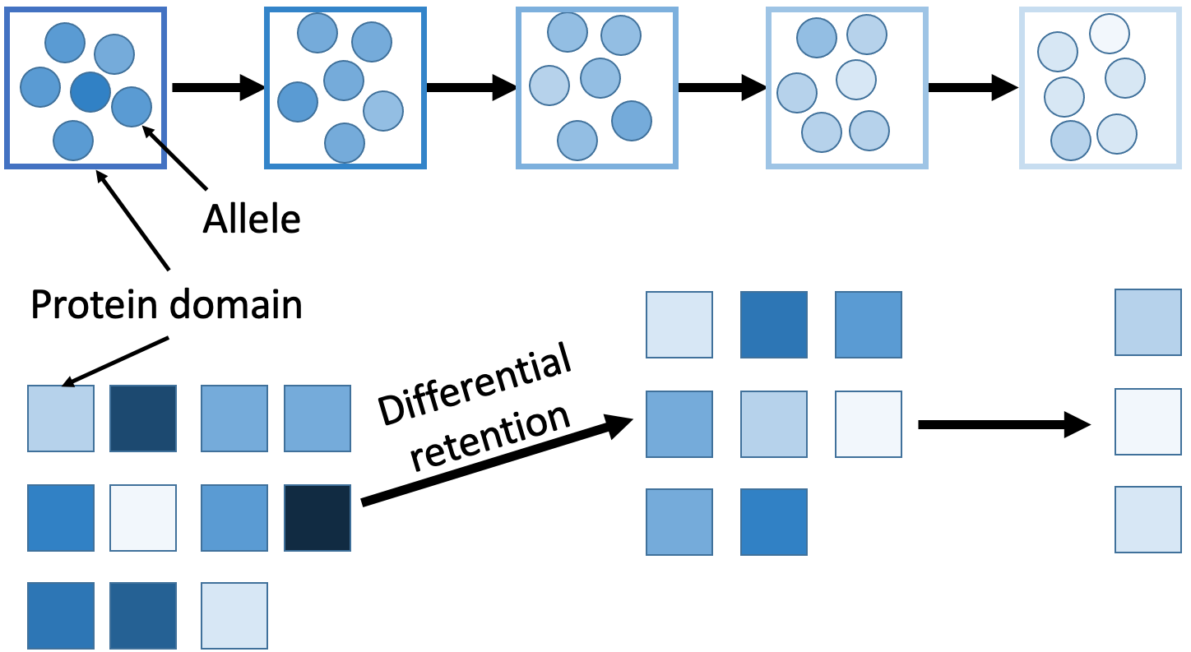
Objective
The differential retention mechanism of proteome evolution postulates that properties of a peptide sequence affect the likelihood of losing that sequence
*domains allow for better phylogenetic reconstruction
Descent with modification
Domain 1
Domain 2
Domain 3
Our goal is to understand how two properties of peptide sequences affect differential retention

Slide 4
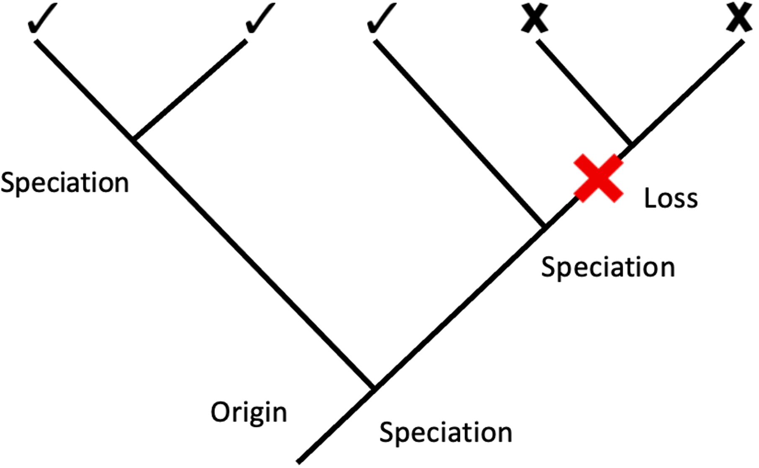
Measuring loss
The loss rate of a protein domain from a lineage (i.e., branches in the phylogenetic tree with crosses; checks retain at least one instance) is a representative measure of the extinction rate
Protein domain loss rates (losses/million years) were calculated by James et al., 2023, based on maximum likelihood using an animal species tree
  less prone to horizontal gene transfer

Slide 5


Data collection and analysis
Data collection was done in Python
  extracted data from MySQL
All subsequent data analysis, modeling, and figure building was accomplished in R

Slide 6
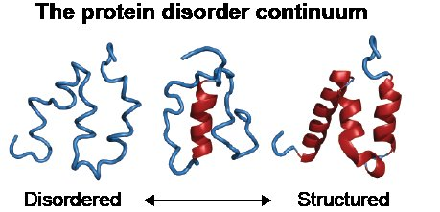
Intrinsic structural disorder (ISD)
ISD is a property of peptide sequences
Disordered sequences have sticky (charged) regions and lack a stable 3D structure

Slide 7
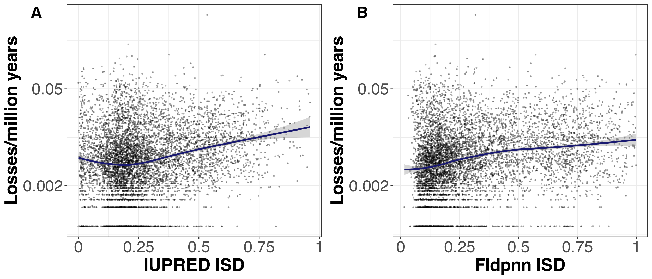
Intrinsic structural disorder (ISD)
James et al., 2023 found that intermediate ISD is the best for retention
Using the newer, better ISD prediction program Fldpnn, we see a monotonic relationship between ISD and loss rate
greater ISD value = higher degree of ISD
Intermediate ISD value
Low ISD value

Slide 8
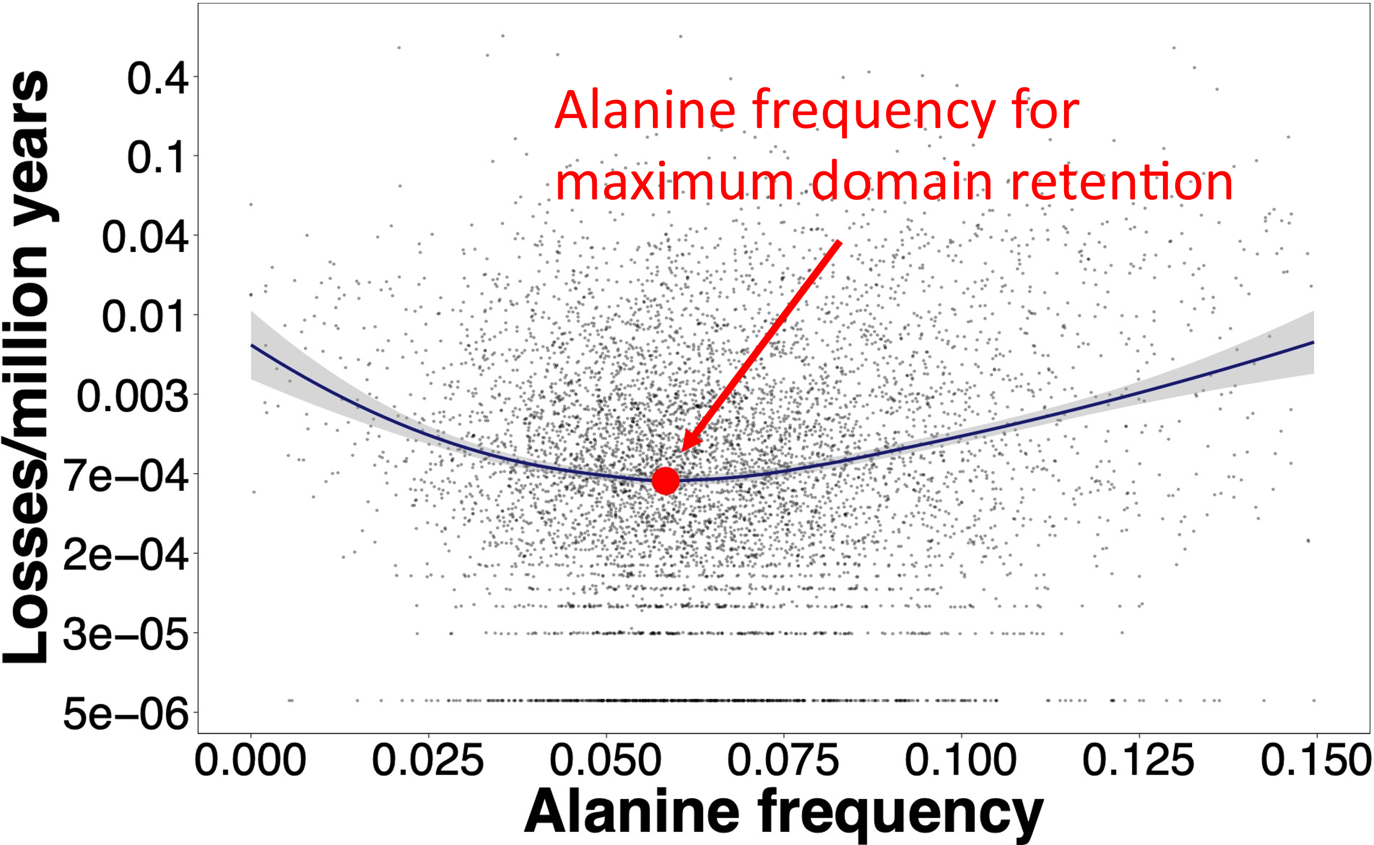
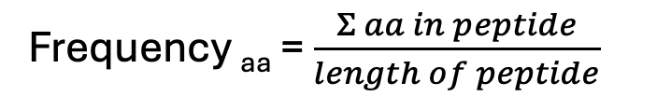
Amino acid frequency
Amino acid frequency is another property of peptide sequences
Easily calculated from the contents of the sequence
Frequency _{aa} = $\frac{Σ aa in peptide}{length of peptide}$
RMEDRPGLKEYCKQRNRAKIPV
RMENRPGLKPYCKQRNRAKIED
RLGDKPRIKEYCMRREASKIPV

Slide 9
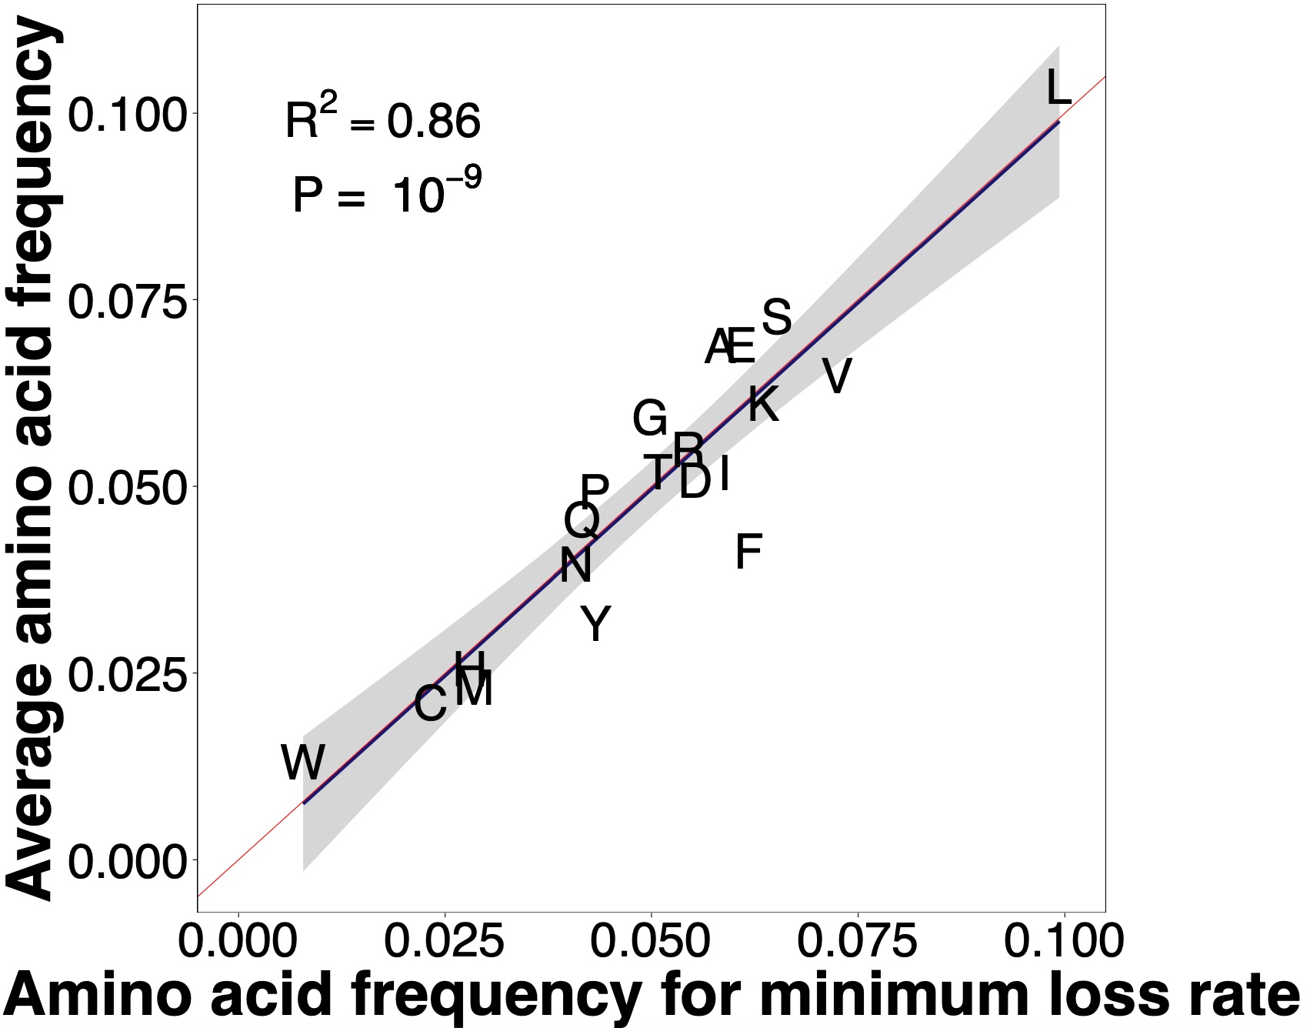
Amino acid frequency
Amazingly, the amino acid frequencies that correspond to minimal loss are approximately equal to the average amino acid frequencies!

Slide 10
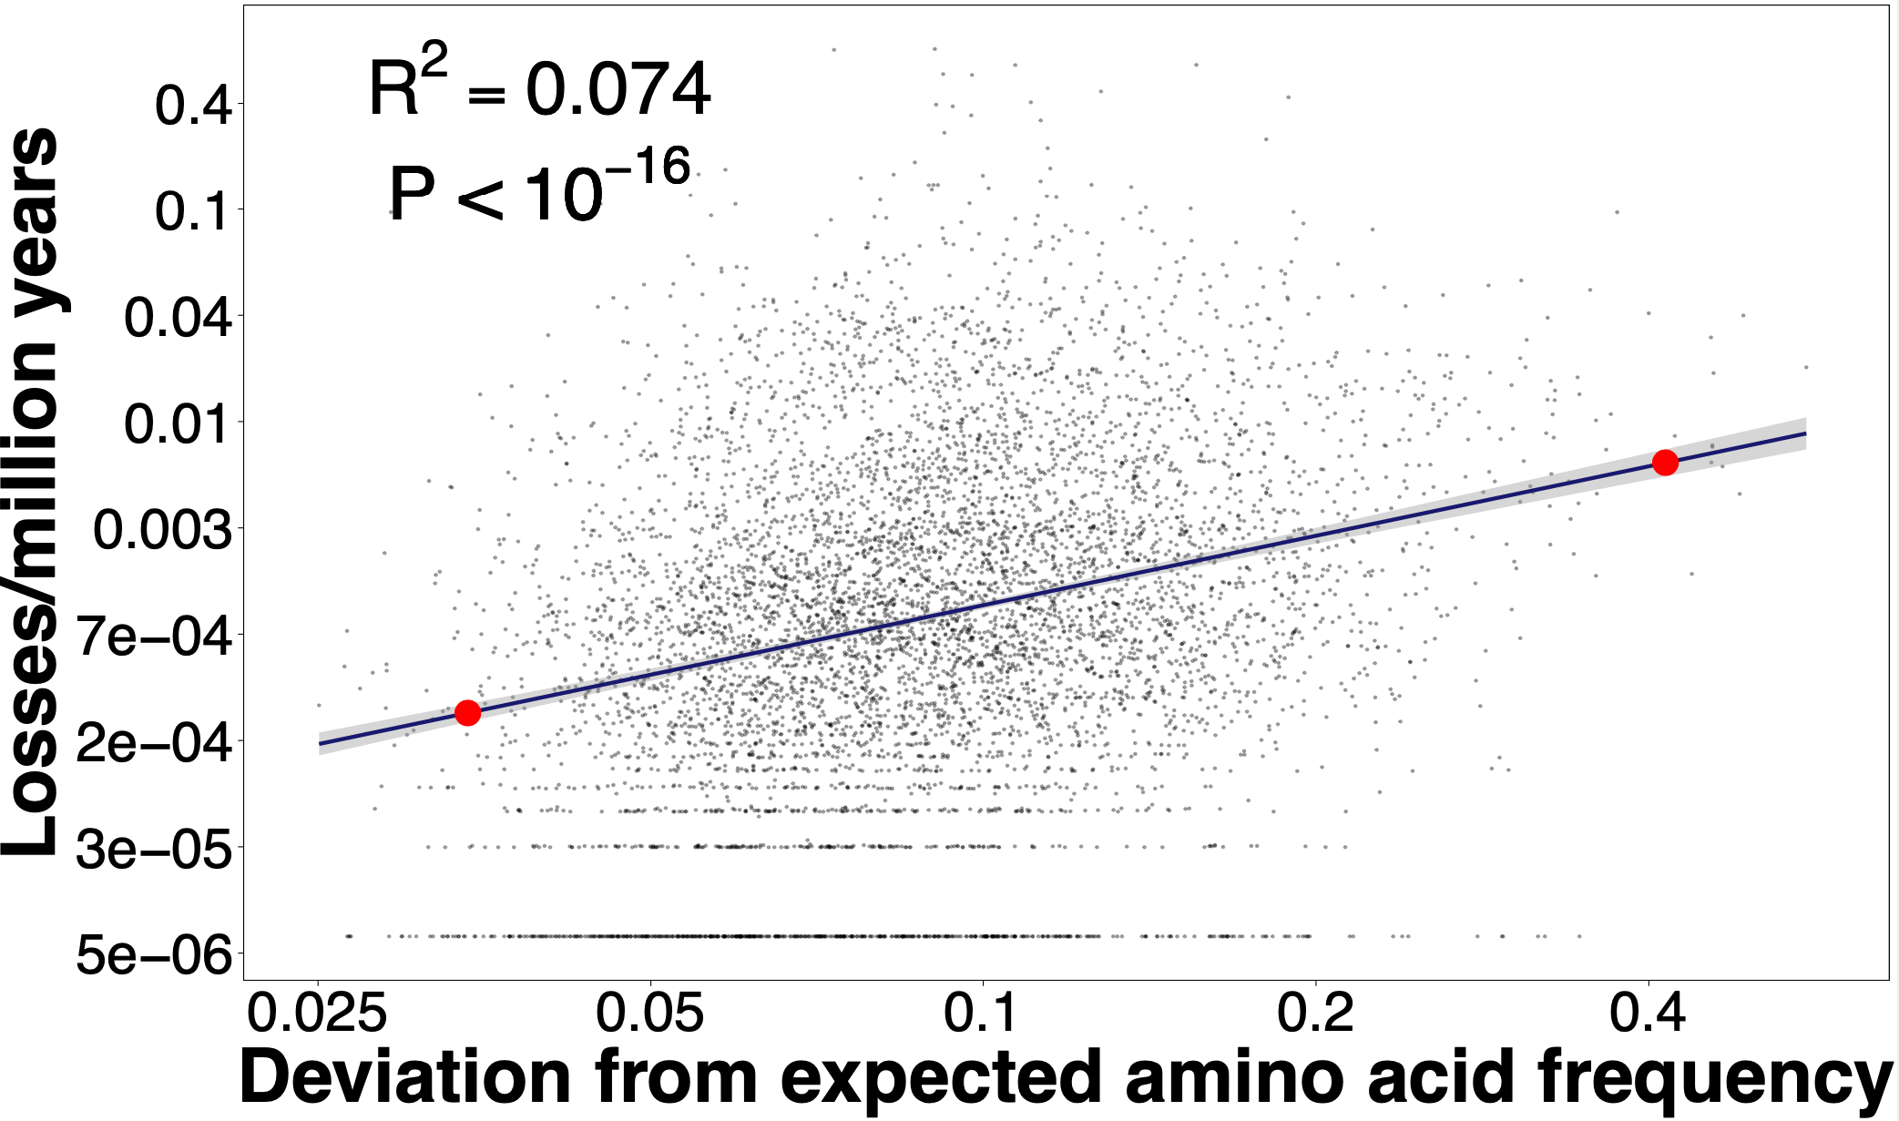
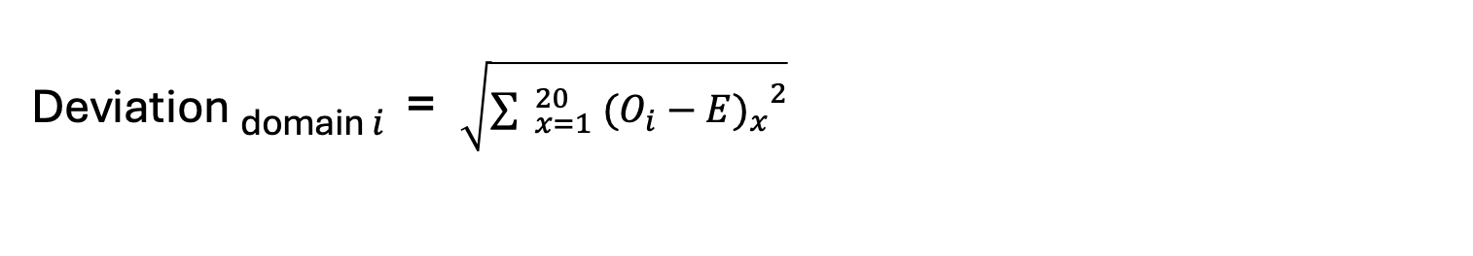
Amino acid frequency deviation
We devised a deviation metric to evaluate the combined effect of a domain's amino acid frequencies on loss
Deviation _{domain} $i$ = $\sqrt{\sum{ _{x=1}^{20} {{(O_{i}−E)}_{x}}^{2}}}$
29x difference in loss rate
90% quantile
10% quantile

Slide 11
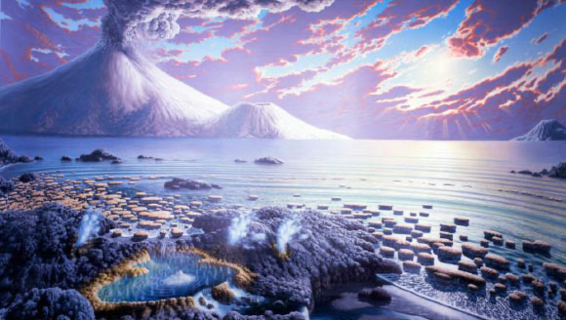
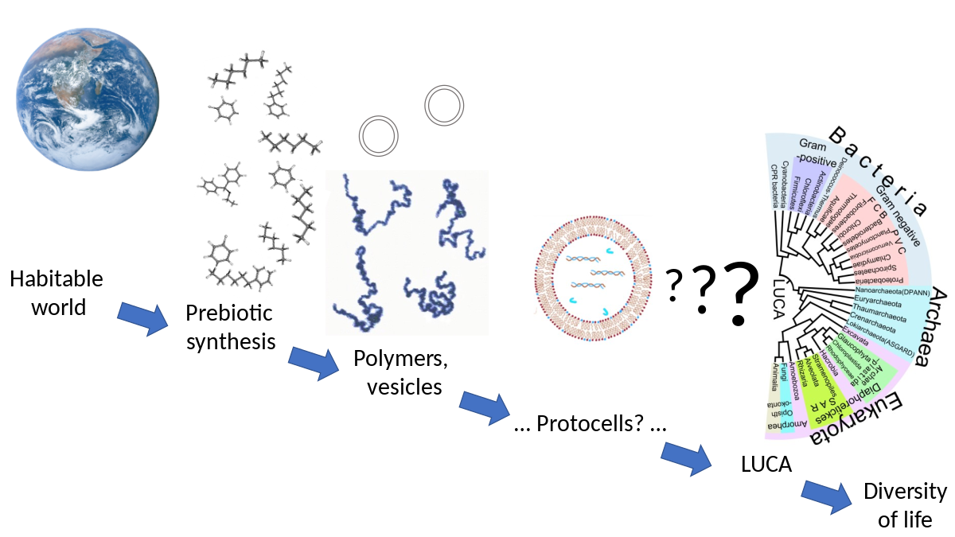
Significance of results
Aid in elucidating trends in long term evolution
Make predictions and estimations about ancient life
Help build complex models to contextualize random peptide sequences

Slide 12
Thank you

